Slide 1
Quantitative Composition of Compounds
Chapter 7
Outline
The Mole Concept
Mole
Avogadro’s Number
Molar Mass
Conversions
Percent Composition
Empirical Formula
Molecular Formula

Slide 2
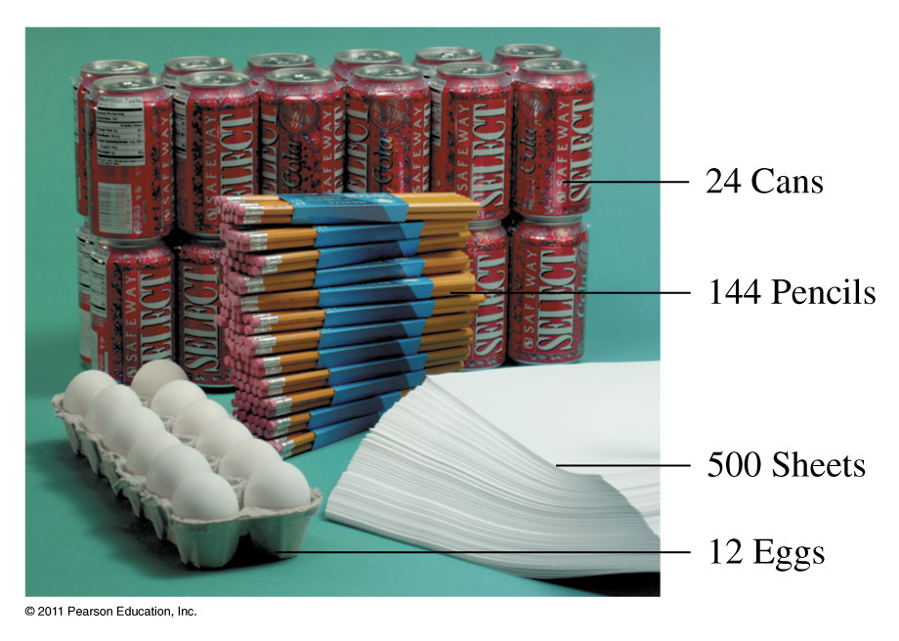
Counting – the mole and Avogadro’s number
Collections of items include dozen, gross, and mole.

Slide 3
Example – The Mole Concept
An orange truck contains five dozen oranges, how many oranges are in the truck?

Slide 4
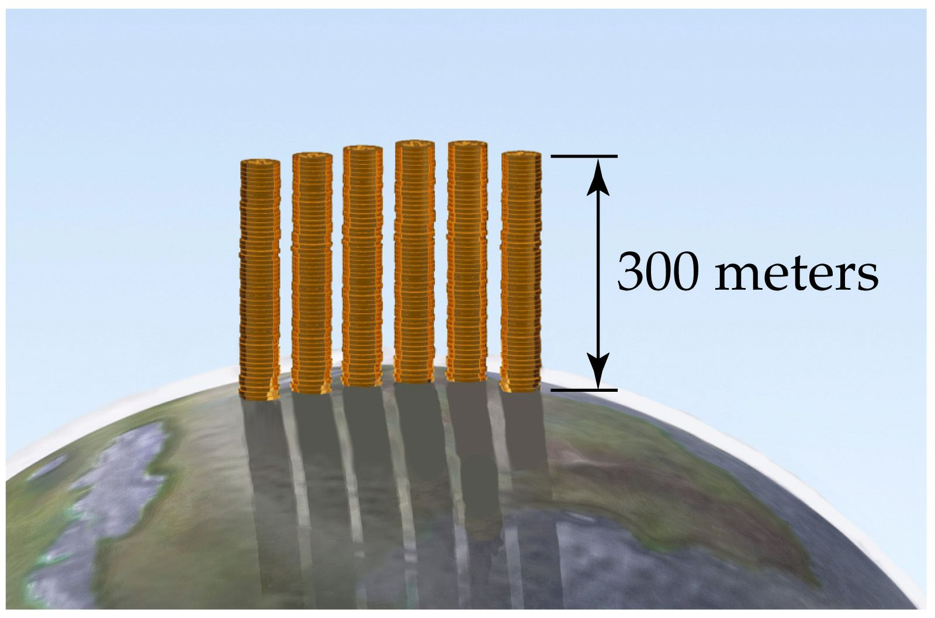

Slide 5
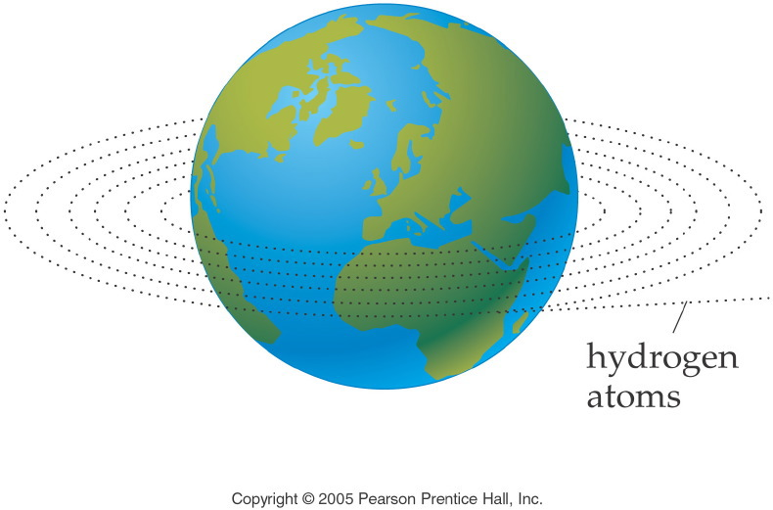
Notes:
Figure: 09-01-01UN
Title:
Length Analogy
Caption:
6.02 x 10²³ hydrogen atoms laid side by side would circle the earth 1,000,000 times.
Notes:
This diagram relates the circumference of the earth to a mole of hydrogen atoms.

Slide 6
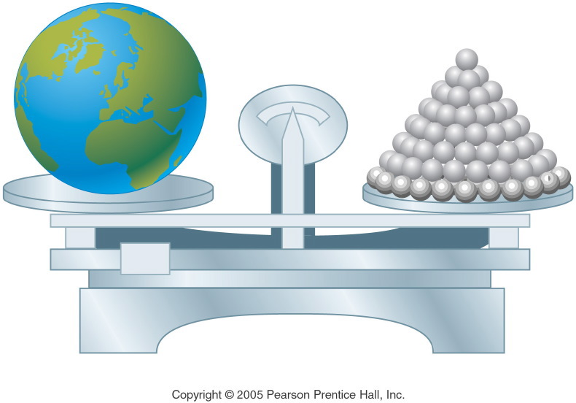
Notes:
Figure: 09-01-02UN
Title:
Mass Analogy
Caption:
6.02 x 10²³ shotput balls have a total mass equal to the mass of the earth.
Notes:
This diagram relates the mass of the earth to a mole of shotput balls.

Slide 7
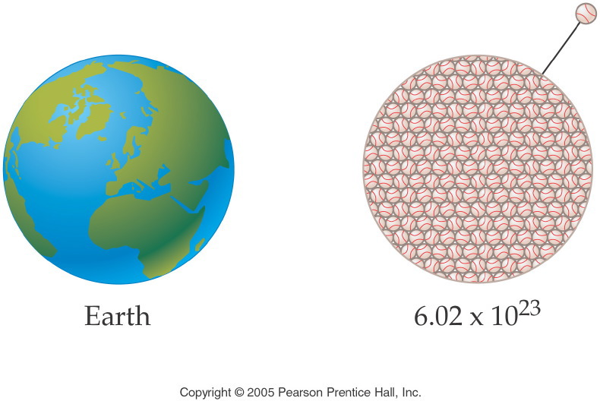
Notes:
Figure: 09-01-03UN
Title:
Volume Analogy
Caption:
6.02 x 10²³ softballs have a total volume equal to the volume of the earth.
Notes:
This diagram relates the volume of the earth to a mole of softballs.

Slide 8
Example – The Mole Concept
A sand truck contains 5 moles of sand, how many grains of sand are in the truck?

Slide 9
Example – The Mole Concept
An orange truck contains 5.62 x 10⁷ oranges. How many moles of oranges are in the truck?

Slide 10
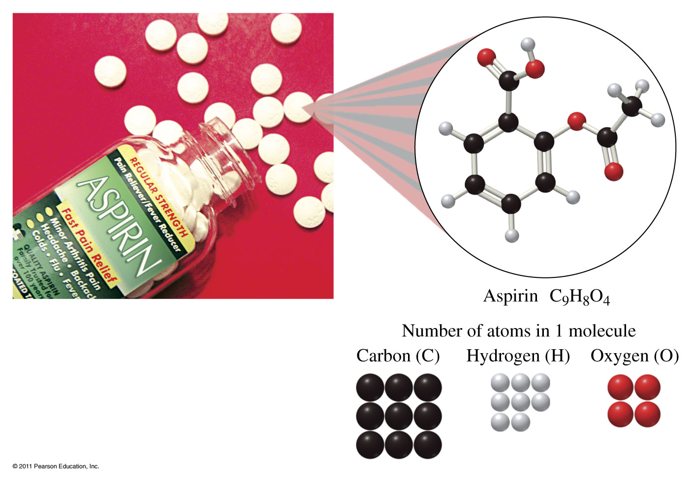

Slide 11
Example – Molar Ratios
How many moles of oxygen atoms are in 2.7 moles of aspirin, C₉H₈O₄?

Slide 12
Example – Molar Ratios
How many atoms of hydrogen are in 2.7 moles of aspirin, C₉H₈O₄?

Slide 13
Example – Avogadro’s Number
How many formula units of sodium bicarbonate, NaHCO₃, are in 0.25 mol of sodium bicarbonate?

Slide 14
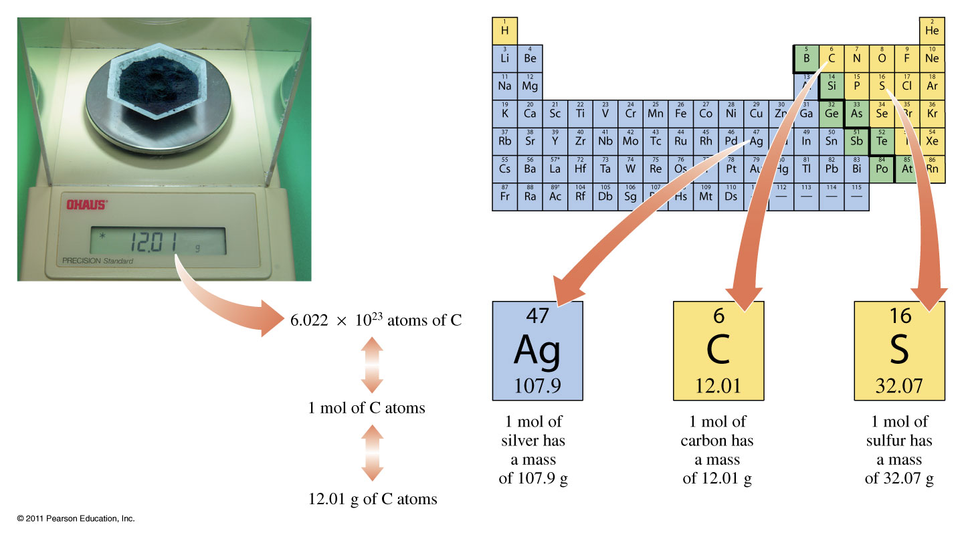
Atomic Mass

Slide 15
Example – Atomic Mass
How many moles of carbon are in 12.4 g sample of coal, which is composed of carbon?

Slide 16
Example – Atomic Mass
If there are 1.72 x 10²³ atoms of Ne in a neon sign, how many grams of neon are there in the glass tube?

Slide 17
Example – Molar Mass
What is the molar mass of aspirin, C₉H₈O₄?

Slide 18
Example – Molar Mass
How many molecules of aspirin, C₉H₈O₄ are in a 200. mg tablet?

Slide 19
Example – Mole Conversions
Lead(II) chromate, PbCrO₄, is a yellow pigment used in paint known as chrome yellow.
If you precipitate 45.6 g of lead(II) chromate, how many moles do you precipitate?

Slide 20
Example – Mole Conversions
Lead(II) chromate, PbCrO₄, is a yellow pigment used in paint known as chrome yellow.
If you precipitate 45.6g of lead(II) chromate, how many moles do you precipitate?
How many atoms of oxygen are in that sample?

Slide 21
Example – Mole Conversions
Hydrogen cyanide (HCN) is a volatile, colorless liquid with the odor of certain fruit pits (peach and cherry). The compound is highly toxic. What is the mass of 3.14 x 10¹⁹ molecules of HCN?

Slide 22
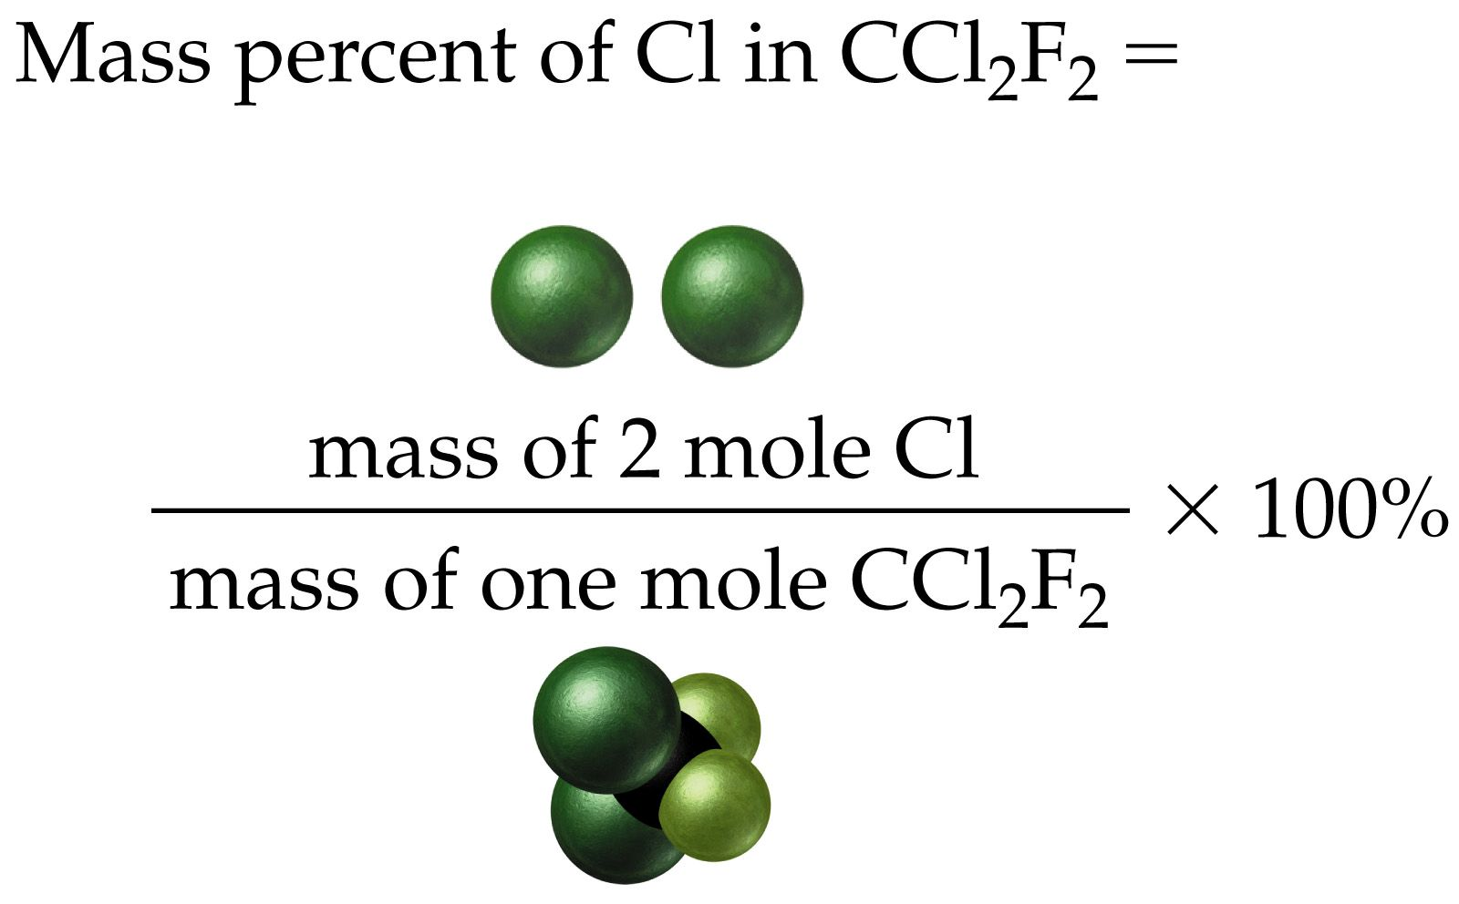
Example – Mass Percent

Slide 23
Example – Mass Percent
Sodium nitrite (NaNO₂) is a food preservative that is added to ham, hot dogs, and bologna. In recent years its use has come under attack because it has been shown to lead to cancer in certain animals. Calculate the percent composition by mass of Na, N, and O in NaNO₂.

Slide 24
Example –Mass Percent
Calculate the percent composition of stearic acid, C₁₈H₃₆O₂, a principle component of saturated fat.

Slide 25
How are molecular and empirical formulas related?
compound name | molecular formula | ratio = molecular/empirical | empirical formula
hydrazine | N₂H₄ | = 2 x | NH₂
peroxide | H₂O₂ | = 2 x | HO
water | H₂O | = 1 x | H₂O
glucose | C₆H₁₂O₆ | = 6 x | CH₂O

Slide 26
Example – Empirical Formula
A compound is found to contain 75.0% carbon and 25.0% hydrogen. What is the empirical formula?

Slide 27
Example – Empirical Formula
The major air pollutant in coal burning countries is a colorless, pungent gaseous compound containing only sulfur and oxygen. Chemical analysis of a 1.078 g sample of this gas showed that it contained 0.540 g of S and 0.538 g of O. What is the empirical formula of this compound?

Slide 28
Empirical Formula from % Composition
Polystyrene, a well-known plastic, is composed of 92.26% carbon and 7.74% hydrogen.
How many grams of each element are in 100 grams of polystyrene?
How many moles of each element are in 100 g of polystyrene?
What is the mole ratio in integers?
What is the empirical formula?
The typical polystyrene molecule has a molar mass of 100,000 to 400,000. If the molecular mass of the polystyrene sample is 182,266 g/mol, what is the molecular formula?

Slide 29
Example – Empirical Formula
Ascorbic acid (vitamin C) cures scurvy and may help prevent the common cold. It is composed of 40.92% C, 4.58% H, and 54.50% O.
What is the empirical formula of ascorbic acid?
What is the molecular formula, if the molecular mass is 176.21 g/mol?

Slide 30
Example – Empirical Formula
TNT, trinitrotoluene, is composed of 37.01% carbon, 2.22% hydrogen, 18.50% nitrogen, and 42.26% oxygen. Determine its empirical formula.

Slide 31
Example - Molecular Formula
The empirical formula of ethanoic acid, the important ingredient of vinegar, is CH₂O. What is the molecular formula of the compound, given that its molar mass is around 60 g/mol?

Slide 32
Example - Molecular Formula
Nicotine is an alkaloid found in the nightshade family of plants. It is present in small amounts in eggplant and tomato plants, but makes up 0.6-3.0% of the dry weight of tobacco. Nicotine has an empirical formula of C₅H₇N and a molar mass of about 160 g/mol. What is the molecular formula?

Slide 33
Example – Molecular Formula
A compound containing only sulfur and nitrogen is 69.6% S by mass; the molar mass is 184 g/mol. What are the empirical and molecular formulas of the compound?

Slide 34
Example – Molecular Formula
Fluorocarbonyl hypofluorite was recently isolated, and analysis showed it to be 14.6% C, 39.0% O, and 46.3% F. If the molar mass of the compound is 82 g/mol determine the empirical and the molecular formula for the compound.

Slide 35
Example – Molecular Formula
Adipic acid is used in the manufacture of nylon. It’s molar mass is about 146 amu, given its percent composition is 49.30% C, 6.91% H, and 43.79% O (by mass), what is the molecular formula?

Slide 36
Example – Empirical Formula
Phenol, commonly known as carbolic acid, was used by Joseph Lister as an antiseptic for surgery in 1865. Its principle use today is in the manufacture of phenolic resins and plastics. Combustion of 5.23 g of phenol yields 14.67 g CO₂ and 3.01 g H₂O. Phenol contains only C, H, and O. What is the empirical formula of phenol?

Slide 38
Additional mole practice
How many moles of nitrogen are in a sample of oxalamide (C₂H₄N₂O₂) that contains 6.4 moles of hydrogen?

Slide 39
The artificial sweetener Nutrasweet is the compound aspartame, with the molecular formula C₁₄H₁₈N₂O₅. What is the molecular mass of aspartame?
What is the mass of 0.362 mol of aspartame?
How many molecules of aspartame are there in 2.55 grams of aspartame?
How many atoms of oxygen are there in 2.55 grams of aspartame?

Slide 40
Calculate the number of moles in 200 mg of a (1 carat) diamond (C).

Slide 41
Male silkworm moths are attracted to an organic sex attractant with a molecular mass of 238. If 4.10 x 10⁻⁶ g of this attractant is released into a room, how many molecules of attractant are in the room?
How many atoms of carbon are present in 1.00 g of CH₄O?

Slide 42
How many moles of formaldehyde (CH₂O MM=30.03) are present in 65.0 g of formaldehyde?
What is the mass of 1 atom of gold?

Slide 43
For glucose (C₆H₁₂O₆) calculate
Molecular mass
Number of molecules in 8.35 mol glucose.
Number of atoms oxygen in 9.43 mol glucose.
Number of molecules in 29.4 g glucose.
Number of atoms of carbon in 29.4 g glucose.
Moles of carbon in a glucose sample containing 4.22 mol hydrogen.
Mass of hydrogen in 3.59 x 10²⁵ molecules glucose.

Slide 44
How many moles of water contain 5.23 x 10²⁴ molecules of water?
Aluminum (Al) is the third most abundant element in the earth’s crust. It is used in transmission lines, aircraft, and beverage cans. What is the mass in grams of 1.000 x 10¹² (one trillion) Al atoms?

Slide 45
What is the empirical formula for ibuprofen, a headache remedy? Ibuprofen contains 75.69% C, 15.51% O and 8.80% H.

Slide 46
What is the mass of 3.554 x 10²⁵ atoms of selenium?
How many atoms are in 2.500 g of platinum?
What is the mass of one atom of lead(Pb)?

